Slide 1
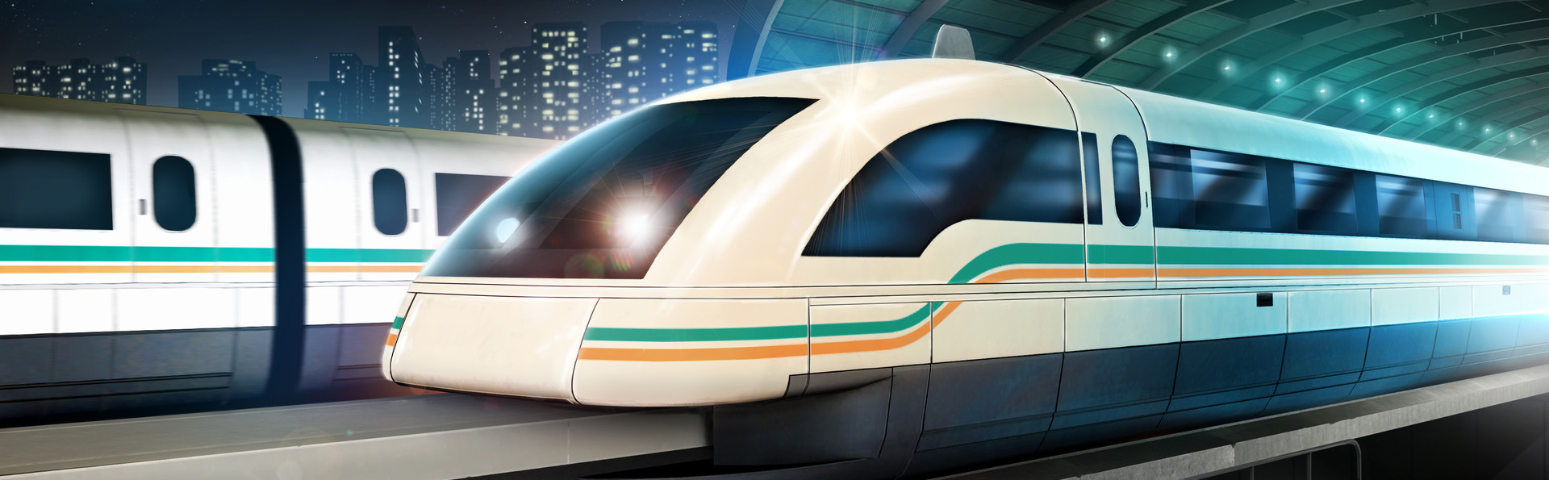
LINEAR INDUCTION MOTOR
Syed Muhammad Abubakar (337385)
Hassan Saqib (344249)
Fiza Ayub (350075)
Maheen Salman (342603)

Slide 2
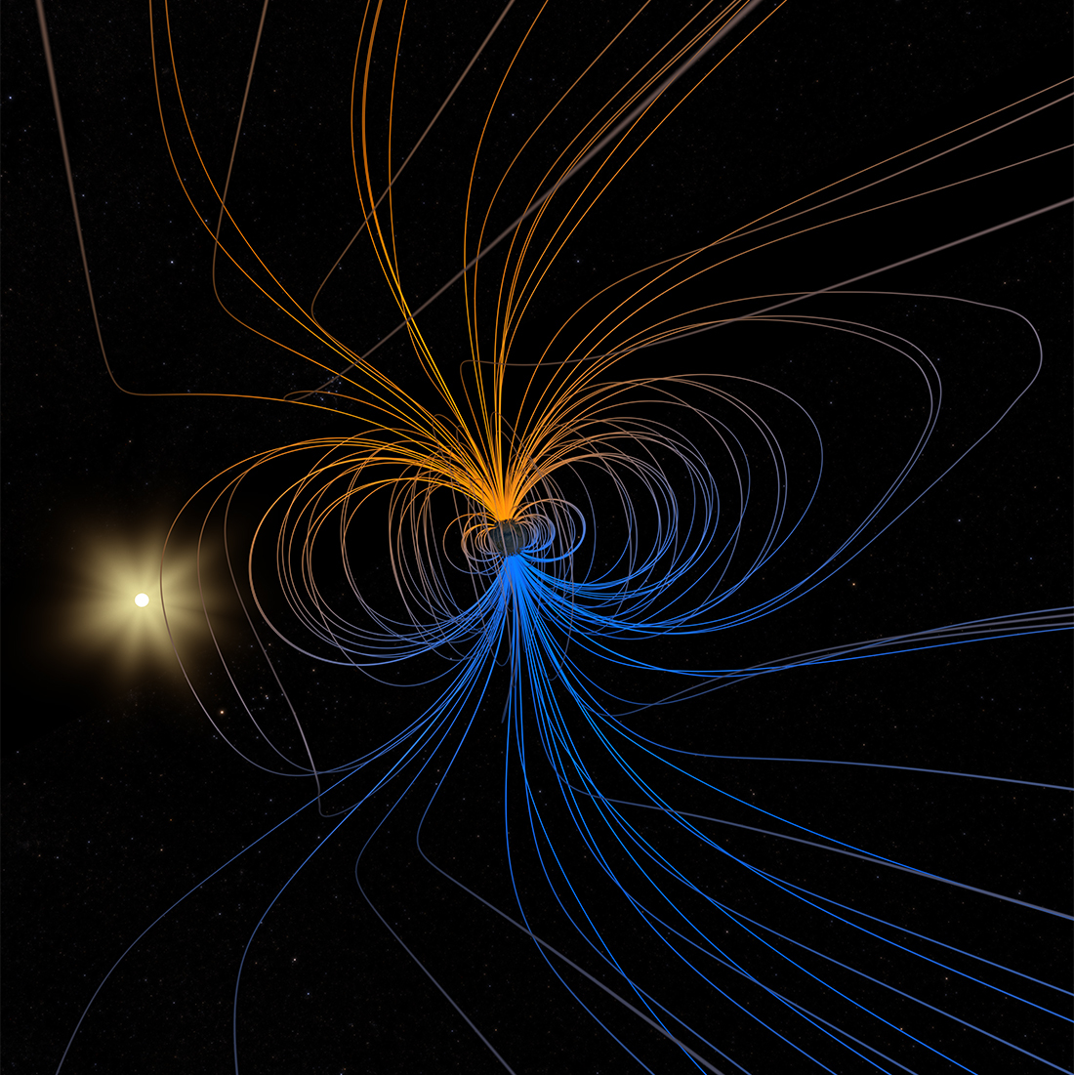
Overview of Presentation
Introduction
Working Principle
Simulation on MATLAB/SIMULINK
Results
Applications

Slide 3
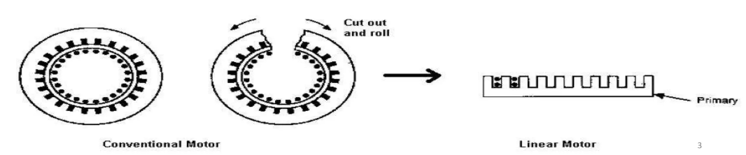
Introduction
Induction Motors are machines that convert electrical energy into mechanical energy with the help of electromagnetic induction.
A Linear Induction Motor (LIM) is an advanced version of rotary induction motor which gives a linear translational motion instead of rotational motion.
A simple way to visualize an LIM would be to simply cut a rotatory induction motor in half, and roll it along its length.

Slide 4
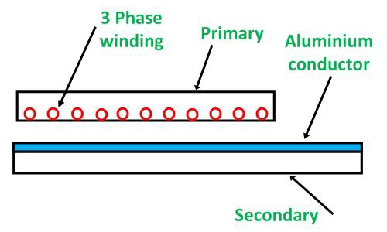
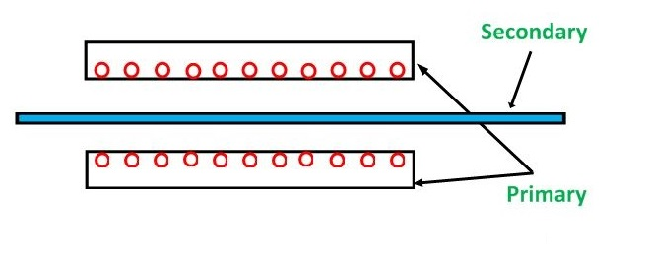
Types of LIMs
SINGLE SIDED LINEAR INDUCTION MOTOR DOUBLE SIDED LINEAR INDUCTION MOTOR
(SLIM) (DLIM)

Slide 5
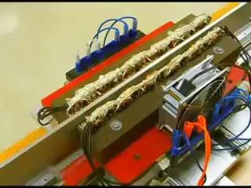
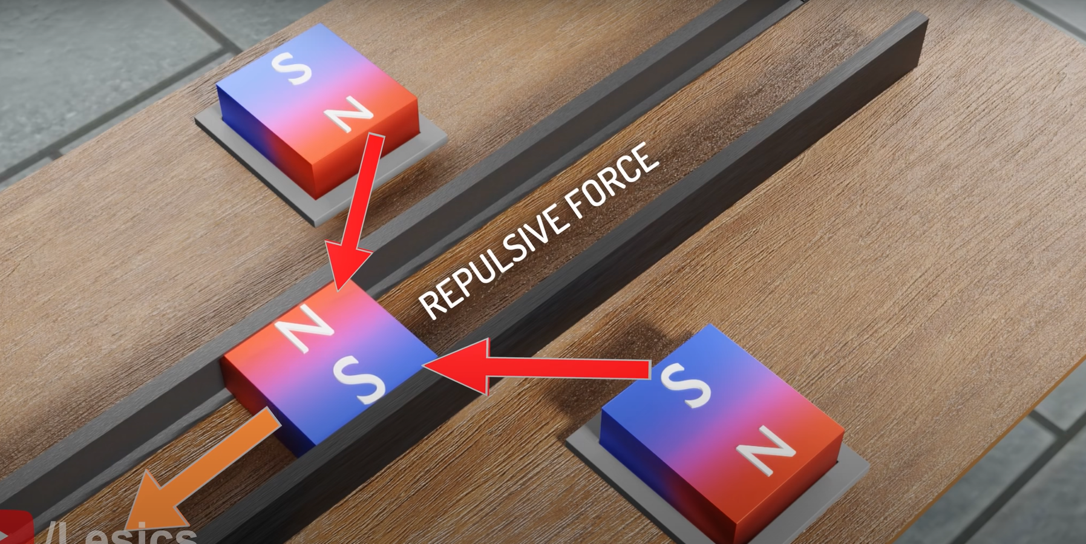
Working of LIMs

Slide 6
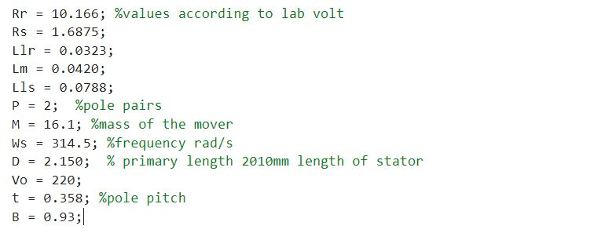
MATLAB Parameters

Slide 7
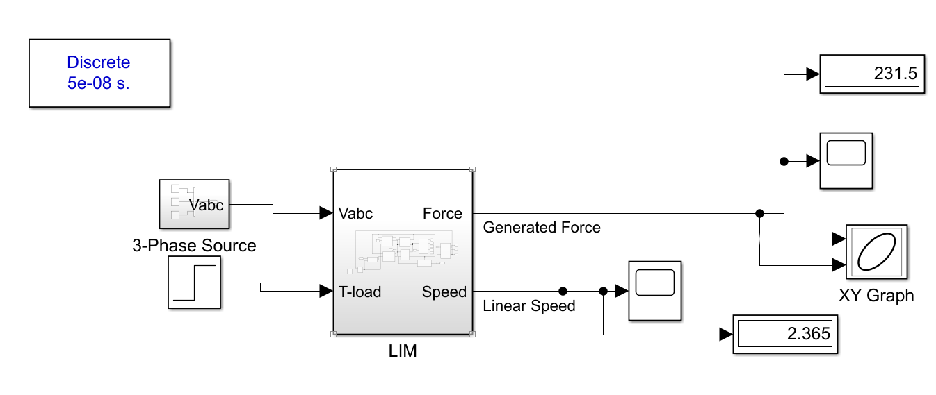
Simulation on SIMULINK

Slide 8
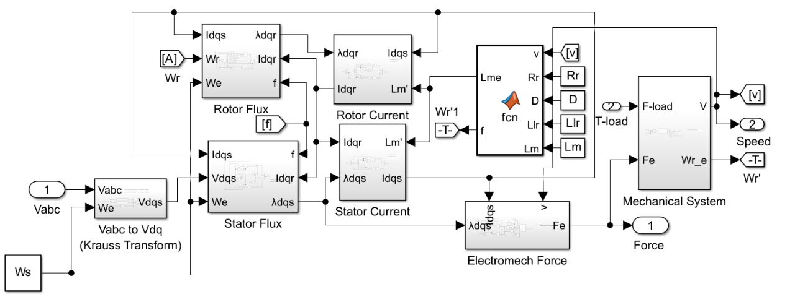

Slide 9
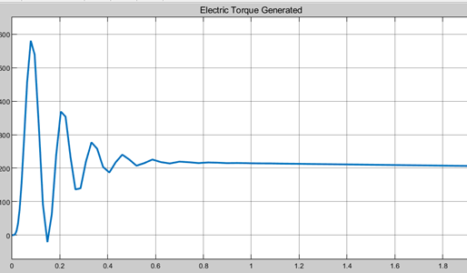
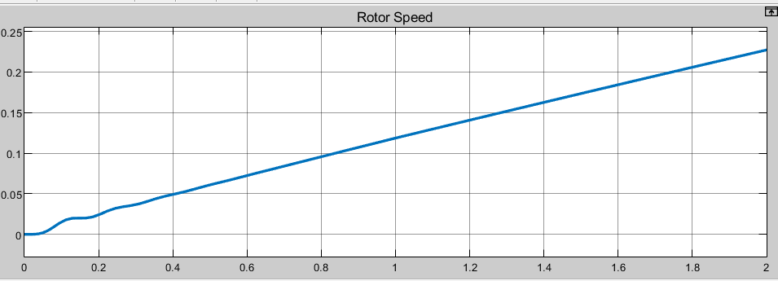
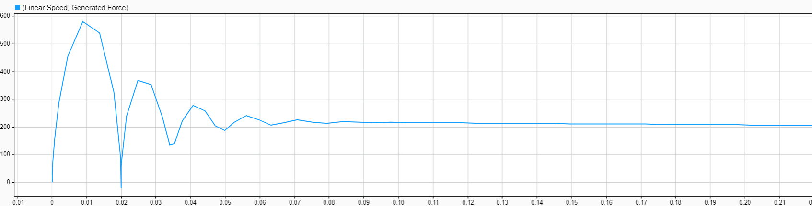
Results and Observations:
Figure 1: Thrust vs. Time
Figure: 2 Speed vs Time
Figure 3: Thrust vs. Speed

Slide 10
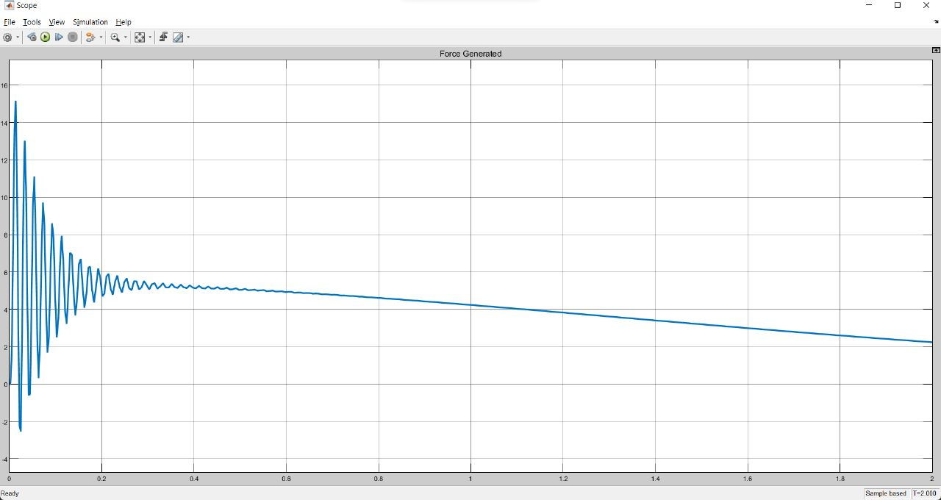
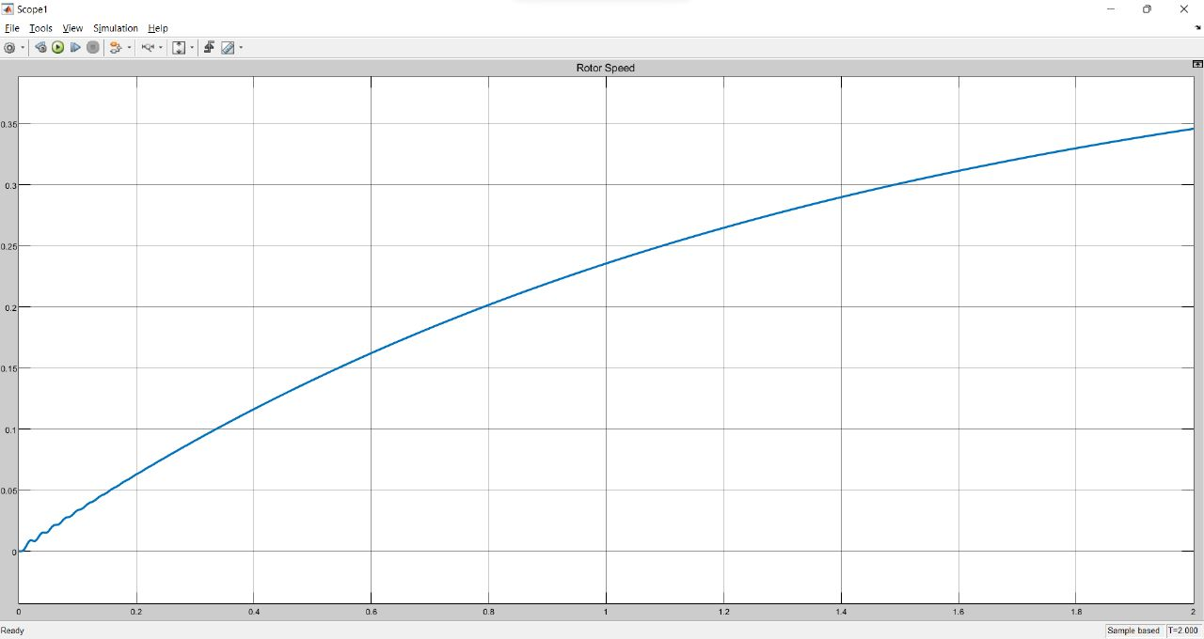
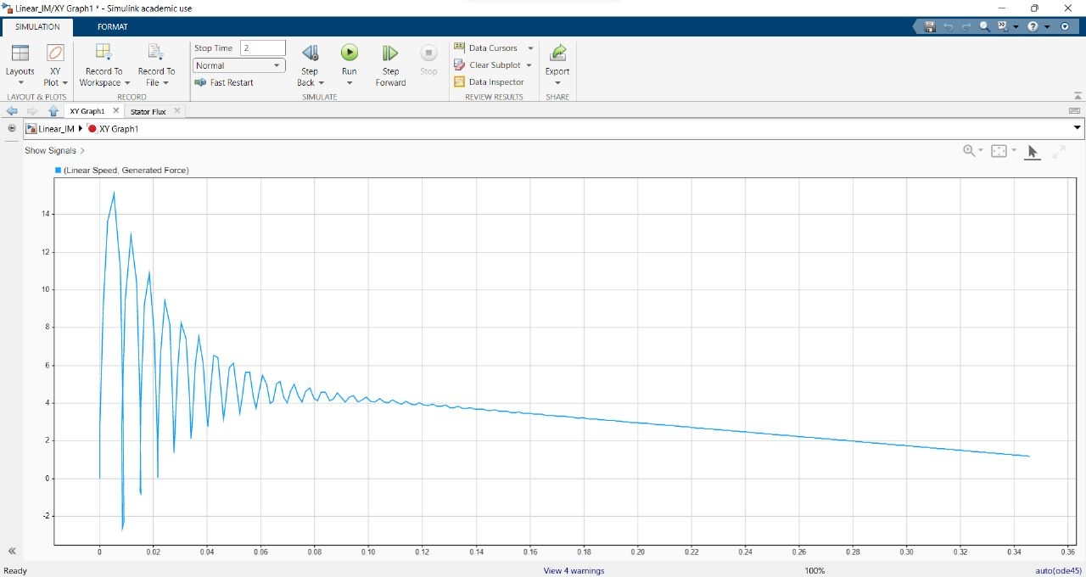
Figure 1: Thrust vs. Time
Figure: 2 Speed vs Time
Figure 3: Thrust vs. Speed

Slide 11
APPLICATIONS
MAGLEV TRAINS:
Maglev trains use magnetism to levitate above the tracks on which they travel. They are faster, efficient, and environmentally friendly than modern wheeled trains.
CONVEYOR BELTS:
A conveyor belt is a material handling system designed to move supplies, materials, and components using an efficient and effortless process that saves on time, energy, and cost.
SLIDING DOORS
The sliding door is operated by a linear motor, which eliminates the need for a belt and frees up space while reducing friction and other factors.
FUTURE RECOMMENDATIONS
Create a DLIM instead of SLIM
Add “Guidance” feature to our machine
Use the principle of Linear Induction in Ropeless elevators
Add component of Friction to make your results more accurate
Ansec software is better for simulating LIM.

Slide 12


